Slide 1
Summer Fun: Introduction to 2D Game Development
Kelvin Sung, 宋賢清
Computing and Software Systems
University of Washington Bothell
Summer 2025
Notes:
Poll

Slide 2
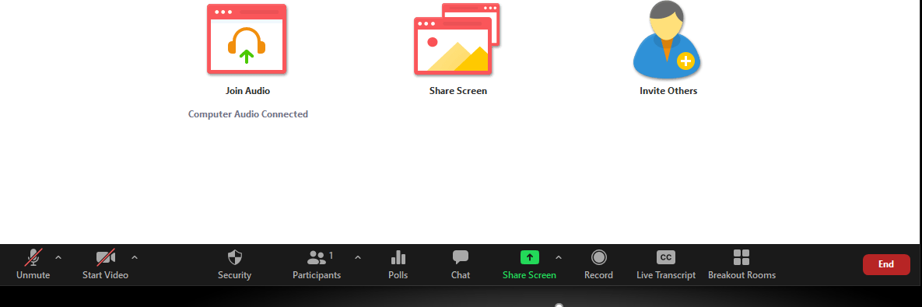
Reminder
Begin recording
Make sure to mute yourself
Unless you have questions (which are welcomed!)
You are welcome to share video
But not compulsory

Slide 3
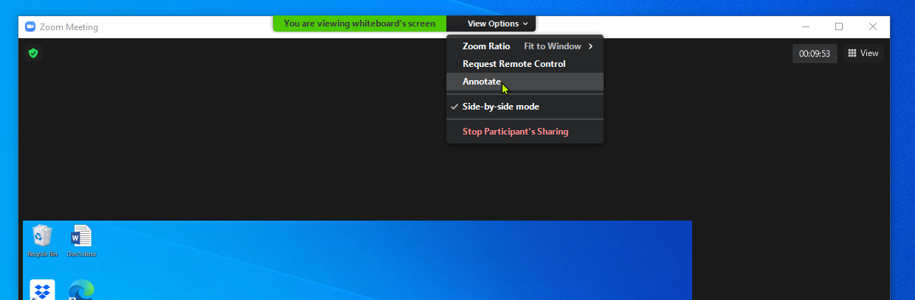
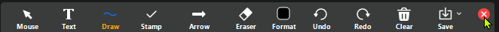
Technology … Zoom
How to annotate
Change draw color
Change draw size
Now annotate on this slide by drawing a check mark in your favorate color:
It’s OK … I can clear everything!
Suggestion on asking question (you can simply un-mute and ask!), or …
Type in your questions in Chat (Chinese is ok), and
Write/Annotate a “Q” on share screen (Anywhere is fine) so that I won’t miss your question
How to exit from annotation
√
Notes:
DEMO how to ask question: Type I question and write “Q”
我的问题是怎么推出 annotate?

Slide 4
Today’s Agenda
WHO:
Who else are in the class, who am I
WHAT:
Topics coverage
WHEN:
Schedule of the class
HOW:
How to do well in class
Example
How I teach what we will learn

Slide 5
Most Importantly: You?
河南大学
天津大学
同济大学
四川大学
南昌大学
南京大学
浙江大学
北京理工大学
北京师范大学
北京邮电大学
湖南师范大学
中国传媒大学
澳门理工大学
齐鲁理工学院
上海交通大学
华中师范大学
华中科技大学
华南理工大学
南方科技大学
西南交通大学
西南财经大学
香港科技大学
西安交通大学
宁波诺丁汉大学
哈尔滨工业大学
哈尔滨工业大学（深圳）
Atlas SkillTech University
Georgetown University
Iowa State University
Wesleyan University
University of Huston
University of Toronto
University of Sheffield
University of San Carlos
University College of Dublin
University College of London
University of British Columbia
University of Southern California
Netaji Subhas University of Technology
Kalinga Instituted of Industrial Technology
Did I miss anyone?
Put a mark (annotate) besides your school, or write your school’s name if I missed you!
Notes:
Learn how to annotate: put a dot or circle your school, or write your school if not here

Slide 6
More About YOu and I …
Where are we from what language do we speak?
China → Mandarin
India → Hindi or Tamil or Bengali or Marathi or Telugu …
Indonesia → Bahasa
Philippines → Filipino
Vietnam → Vietnamese
Ireland → Irish
US/UK → English
Canada → English or French
Me: University of Washington Bothell, Bothell, Washington, US
Do not confuse with the UW Seattle Campus
Countries: Taiwan (China), Singapore, Canada, US
Languages:
A little English, A little Mandarin, tiny little bit of Cantonese

Slide 7
Second Most Important: WHY?
Why are you here?
For fun? … FUN? heard of Beaches? Or Swimming Pools?
To learn?
WHAT do you want to learn?
Singapore culture?
English?
Videogames development and something about game engine?
Software development?
How other cultures teach and learn?
Notes:
Why, Language, Background polls

Slide 8
A Word about Culture:
HELP ME: Take charge of your learning Actively!
Single most important responsibility as a student: Ask me questions!!
YES I mean during class, interrupt me and ask any questions you may have!
!!PLEASE!!
Answer my questions in class, unmute and answer, or type in Chat
Stop me:
When I go too fast!
When I teach things you already know!
Guide me!
You and I: we are here to have fun!
Let’s learn together!

Slide 9
Third Most Important: your background
Programming Languages
C++? C#? Java? PHP? Ruby?
Foundational computer science background?
Object Oriented Programming? Data structures? Operating Systems?
Graphics User Interface (GUI) Programming?
Swing? WPF?
Computer Graphics?
D3D? OpenGL? WebGL?
Notes:
Programming Languages poll
Background poll

Slide 10
your background: my expectations/Hope
Programming Languages … one of
C++ C# Java Python
Foundational computer science background?
YES: Object Oriented Programming and Data structures
A little or not much: Operating Systems?
GUI and Computer Graphics?
A little or not much
LET ME KNOW if you have very different background for the above

Slide 11
A Word about me …
Kelvin Sung (宋賢清) Shandong (山东)-ese from Taiwan (台湾) province
Born in Taiwan, been back to my native land (unfortunately, only when I was 60): Qingdao (青島)
Grew up in Singapore (since I was 6)
Education: in the US since 16
BS in EE: University of Wisconsin-Madison
MS, PHD in CS: University of Illinois at Urbana-Champaign
Experience and Areas of Research
Computer graphics: image synthesis
Maya Renderer: one of the chief designers
More recently: Video games for non-entertainment purposes, remote AR/VR collaboration

Slide 12
Summary of you and I
Your motivations match the goals of this class
Learn/apply knowledge
Teaching and Learning from a different culture
Fun
You have proper backgrounds
Programming languages, technical background (OO + data structures)
You know a little about who I am
We are well-positioned to begin!

Slide 13
Now this class:
2D Videogame Development
Why limit to 2D?
What is the main difference between building a game and other software systems?
We will learn …
The fundamental tool for building a videogame: the game engine
Conceptual and programming model of a game engine and game objects
Essentials of videogames
Fun, the world, UI, behavior, interaction (rigid bodies), effects (illumination, particle systems)
Fundamentals of building a game
Presentation of idea, prototypes to demo feasibility, vertical slice to sell the idea, and, PLAY TESTS
Build a game!
Notes:
2D only: because of time limit. Learning in steps, learn the tools, know how to build, understand the challenges, then, increase the tool complexities to 3D, so, next class.
Games: subjectivity, an Art for others, TESTs + Feedback (Engaging your players in activities)

Slide 14
THIS CLASS
Part I (25th May 2025):
I want to: … teach …
elementary topics
You want to: … learn …
about yourself, your interests
Part II (July 2025):
We want to:
Build the best game ever

Slide 15
THIS CLASS
My style
Fast pace
Passionate
Work hard with everyone in class
You want to decide, if
You want to learn with me, or
You are able to learn from me
Part I (25th May 2025):
I want to: … teach …
elementary topics
You want to: … learn …
about yourself, your interests
Part II (July 2025):
We want to:
Build the best game ever

Slide 16
Part I (25th May): Game Engine and Game Components
Learn: Intro + Environment + Game Engine + a little about Programming Model
Assignment: due 11pm on Tuesday 27th May
Short Quiz: on the Game Engine (should take 10-20 minutes)
Quiz on Canvas to be open after today’s class.
Small Coding Exercise: Exercise 1 (should take about an hour)
Submit to Canvas
Submit: EXE build + Source Code
If you don’t practice, you won’t learn, really!
Very short turnaround! Gives you some sense of the pace for Part II

Slide 17
Part II (July): Build an Awesome Game
Meetings: Every day at 9:00am, until we are done.
Top priorities in the first 3 to 4 days:
Mastery of game engine + Familiarity with real-time interactive applications + Forming Teams!!
Learn: Game Objects, Camera, UI, Game Manager, Effects, Autonomous Behaviors (AI)
Practice: a simple interactive application (individual), a simple game (group project)
Last 10 days: Final Project Development and Progress Demo
How to brainstorm + what is a fun game
Presentation: Your final game proposal
Presentation: Game prototype demo
Presentation + Everyone plays everyone else’s games: Alpha game playtest
Presentation + Everyone plays everyone else’s games: Beta game playtest
Presentation + Whole class plays!

Slide 18
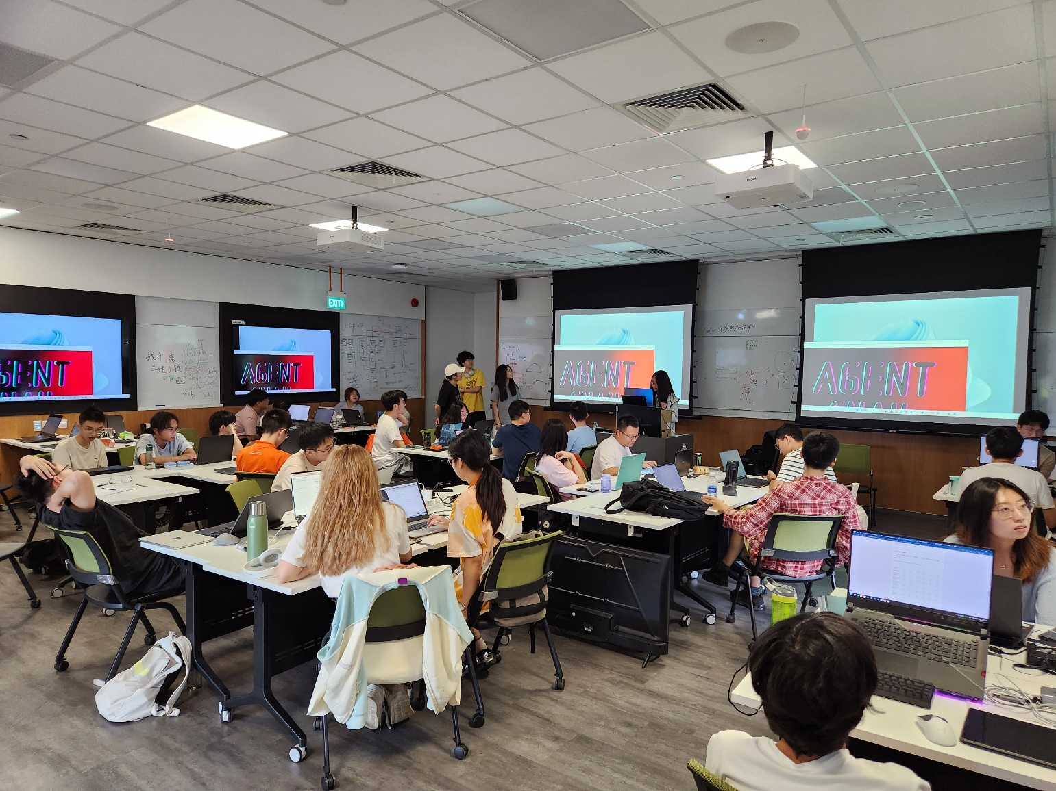
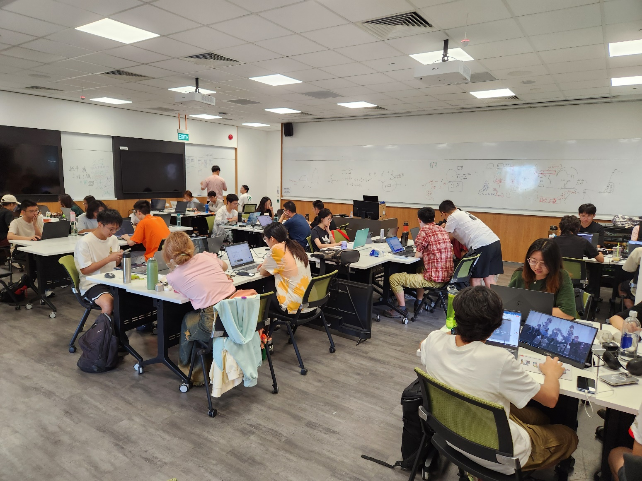
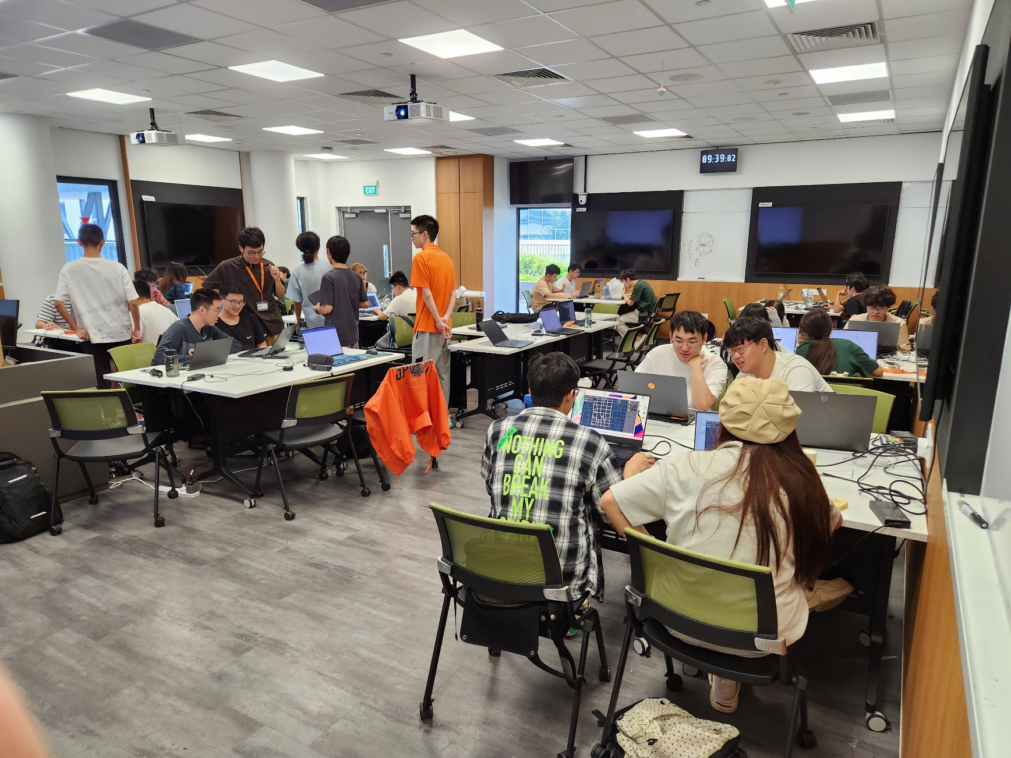
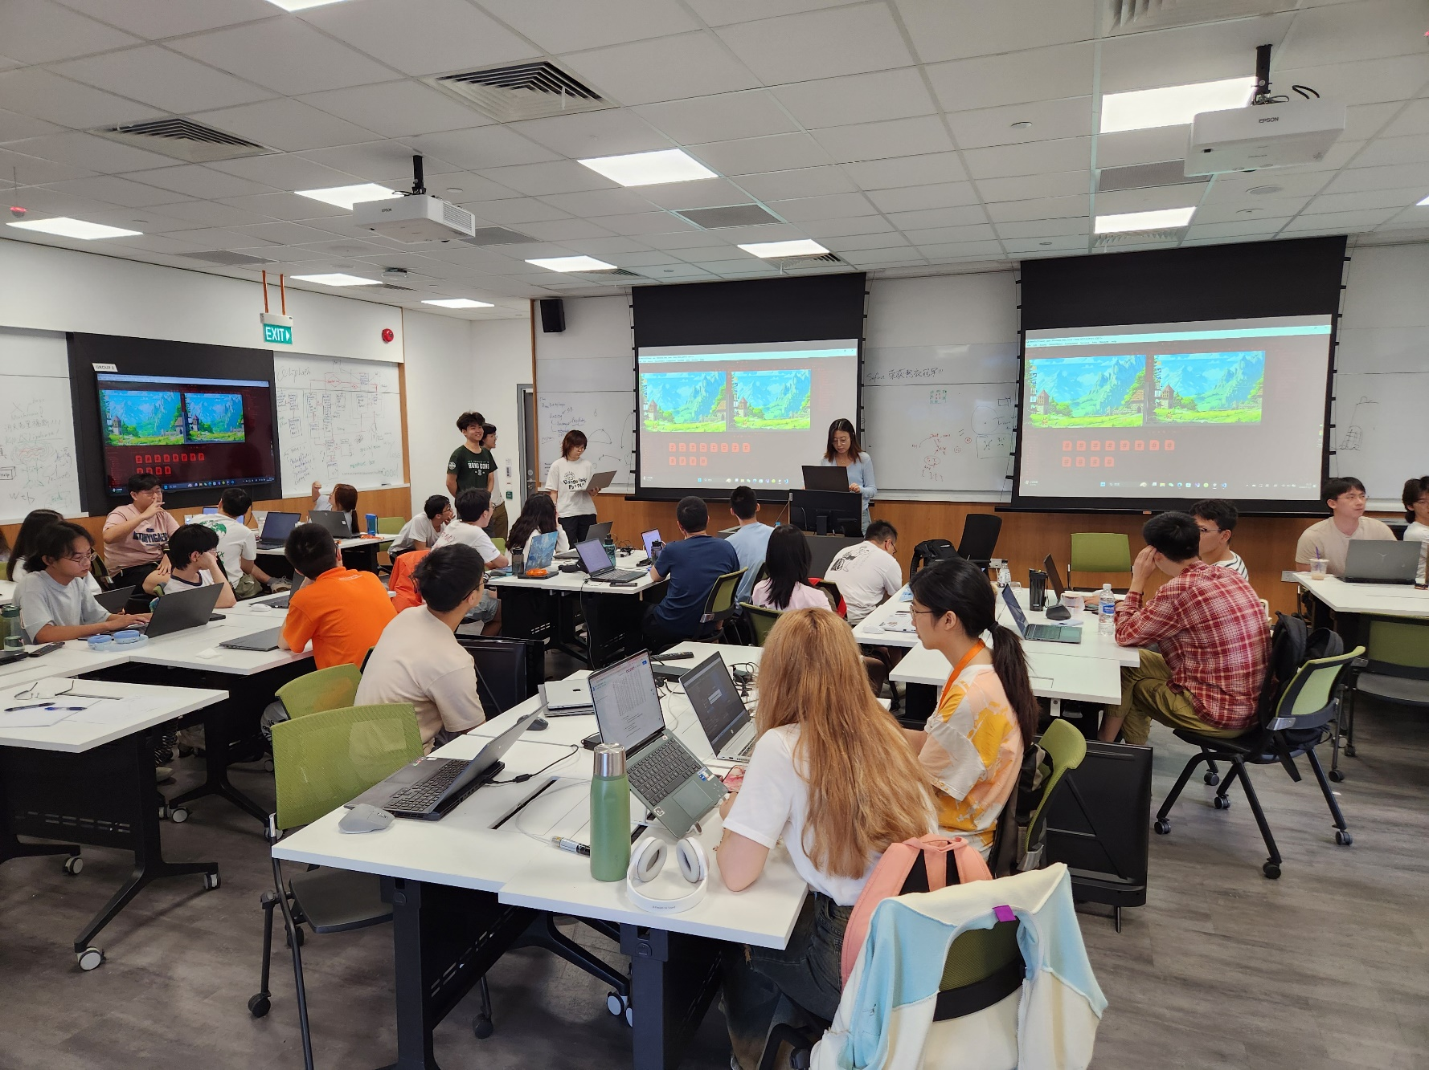
Part II (July): Build an Awesome Game
Meetings: Every day at 9:00am, until we are done.
Top priorities in the first 3 to 4 days:
Mastery of game engine + Familiarity with real-time interactive applications + Forming Teams!!
Learn: Game Objects, Camera, UI, Game Manager, Effects, Autonomous Behaviors (AI)
Practice: a simple interactive application (individual), a simple game (group project)
Last 10 days: Final Project Development and Progress Demo
How to brainstorm + what is a fun game
Presentation: Your final game proposal
Presentation: Game prototype demo
Presentation + Everyone plays everyone else’s games: Alpha game playtest
Presentation + Everyone plays everyone else’s games: Beta game playtest
Presentation + Whole class plays!

Slide 19
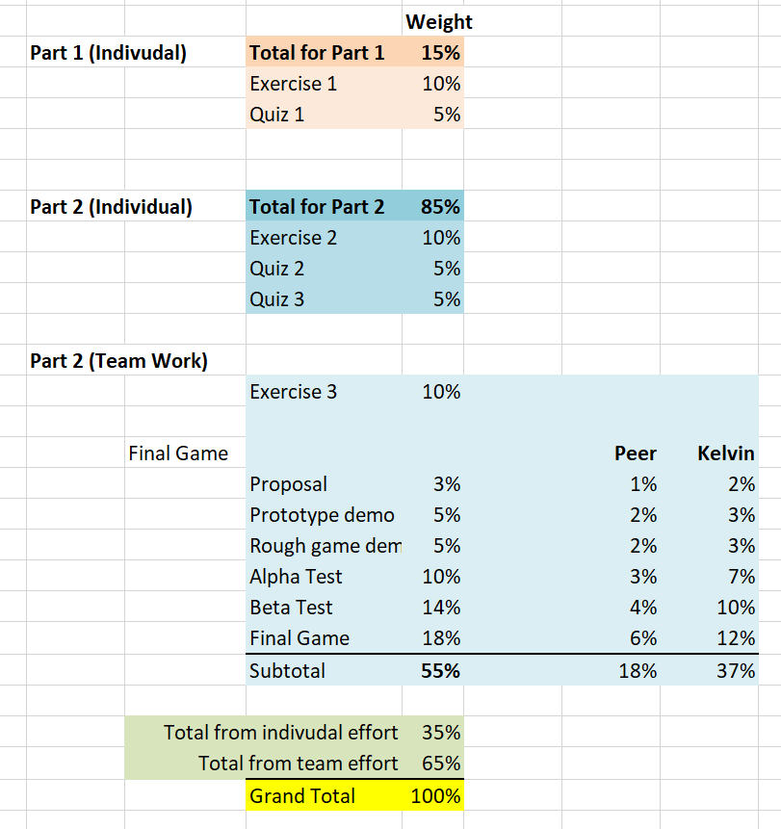
How you Will be EvaluateD
Notes:
Grade from past years: A+ > 95, A 90-95, B>80, VERY seldom anyone gets a C

Slide 20
While Taking this class …
Learning:
Fun: design, program, debug, play videogames, compete(?)
Less fun: no time to sleep, deadlines, compete(?)
Not much time to:
Shop, hike, explore, swim, chat
Team work:
About yourself, and
Who you want to work with

Slide 21
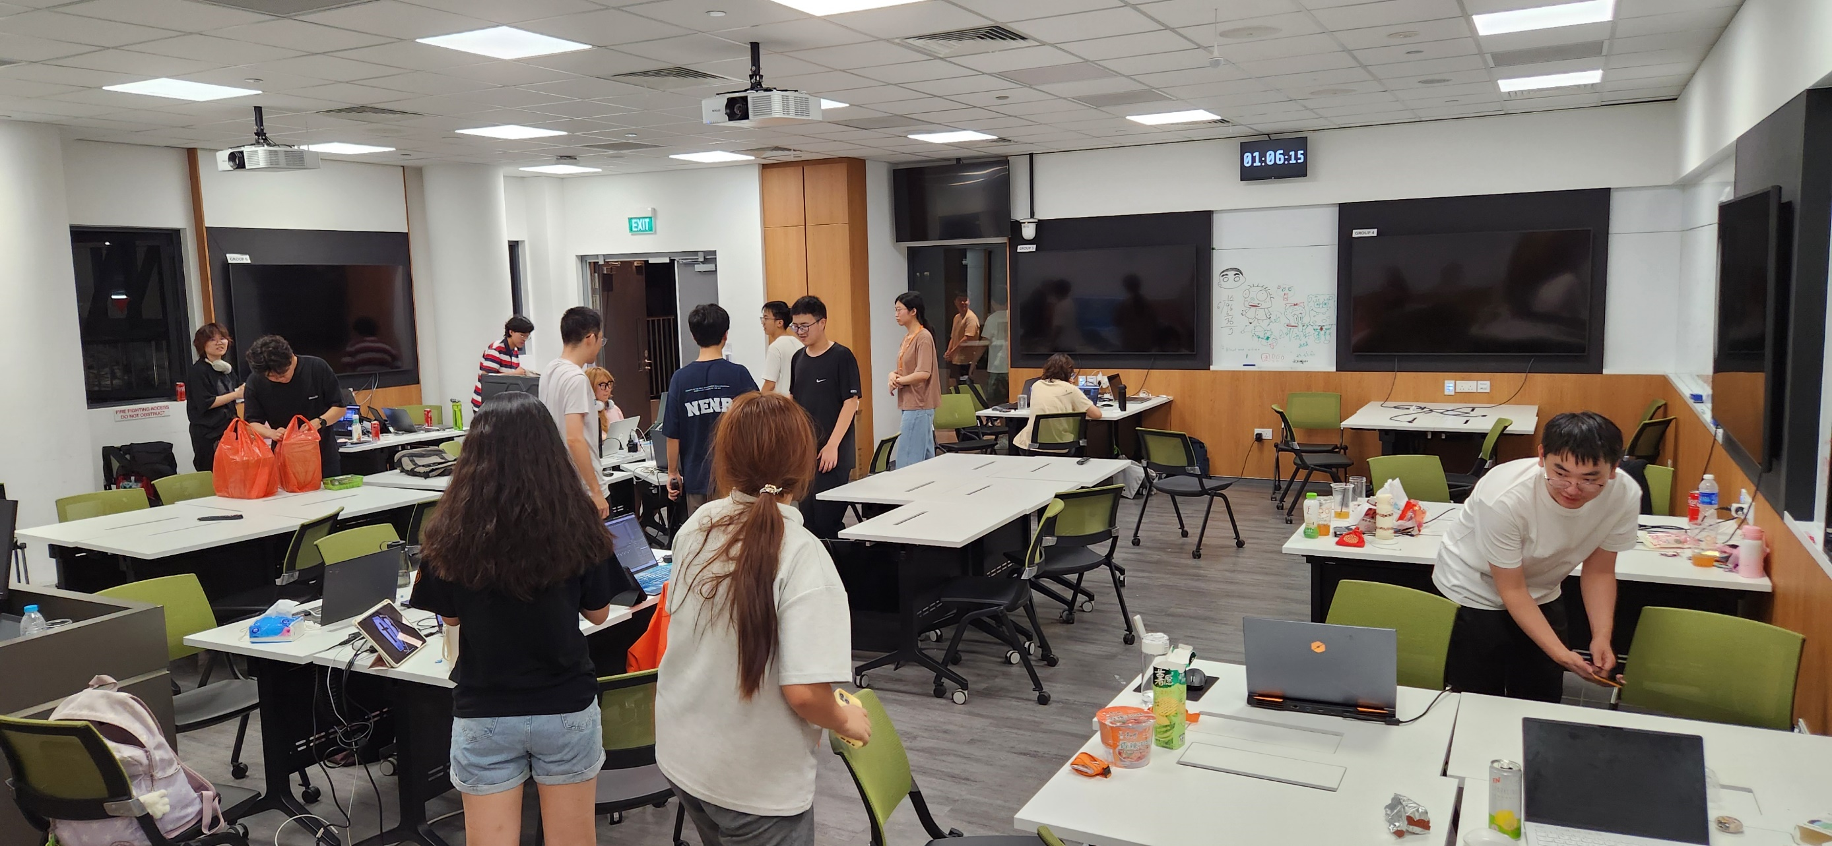

While Taking this class …
Learning:
Fun: design, program, debug, play videogames, compete(?)
Less fun: no time to sleep, deadlines, compete(?)
Not much time to:
Shop, hike, explore, swim, chat
Team work:
About yourself, and
Who you want to work with

Slide 22
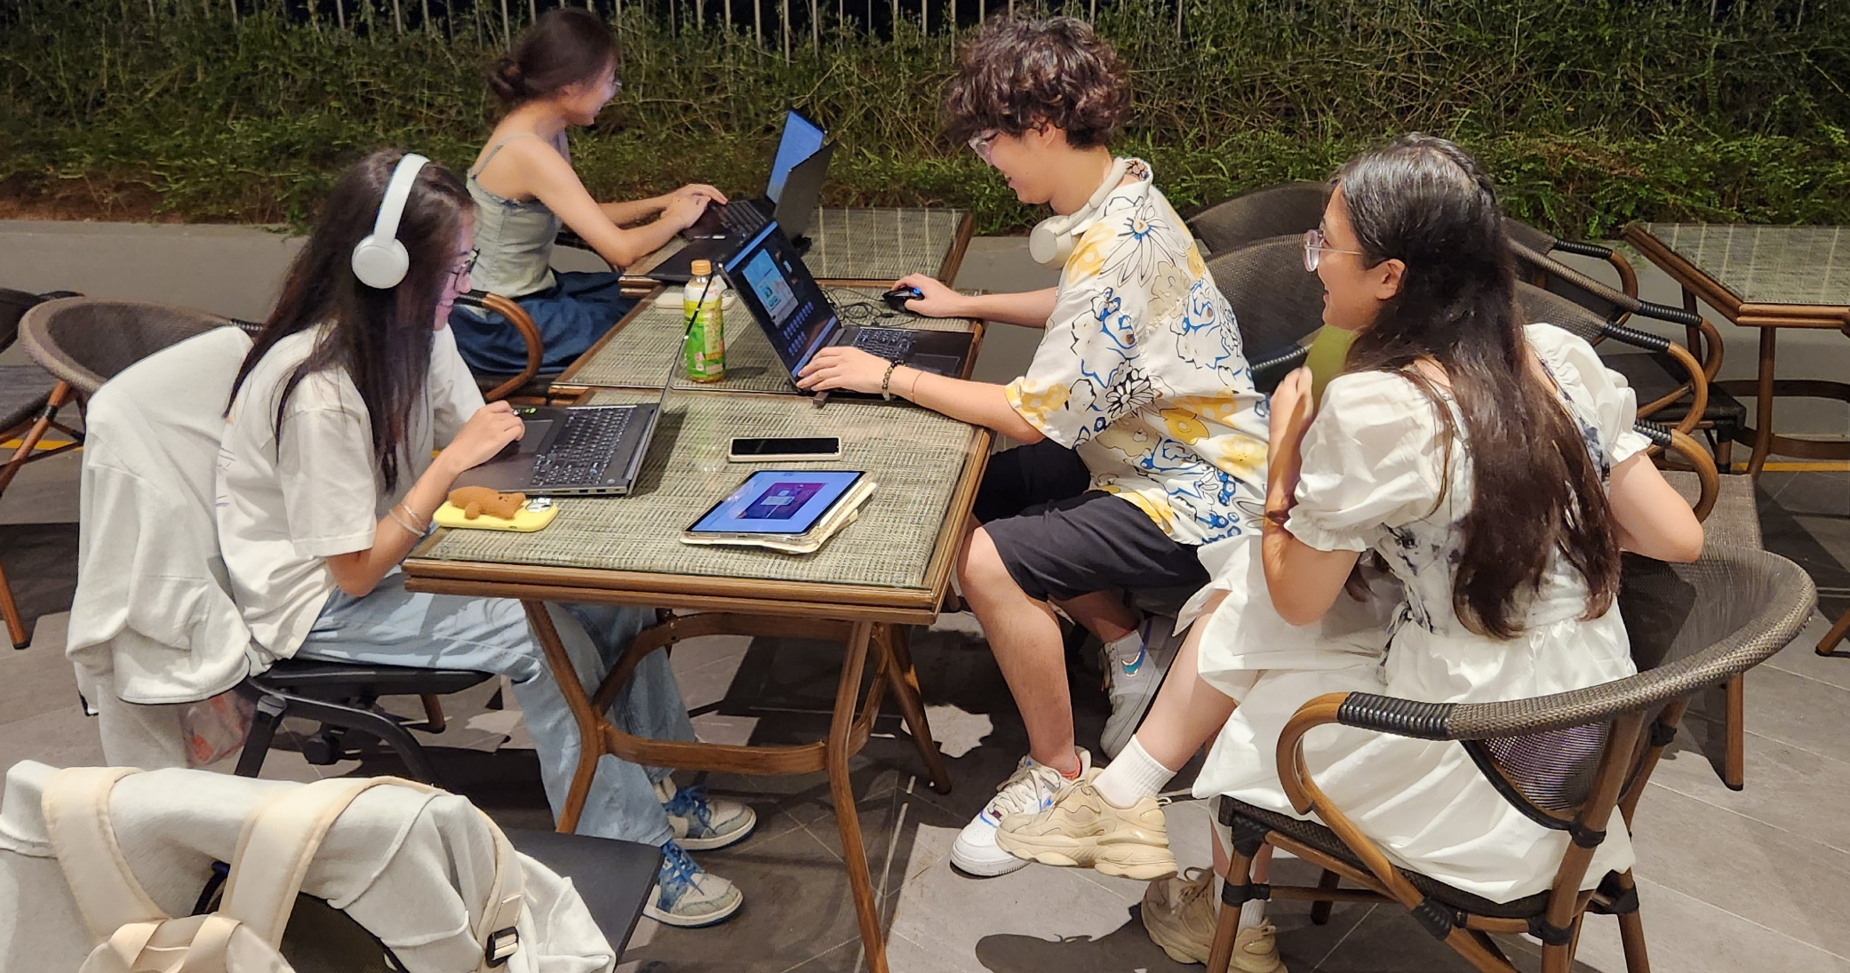
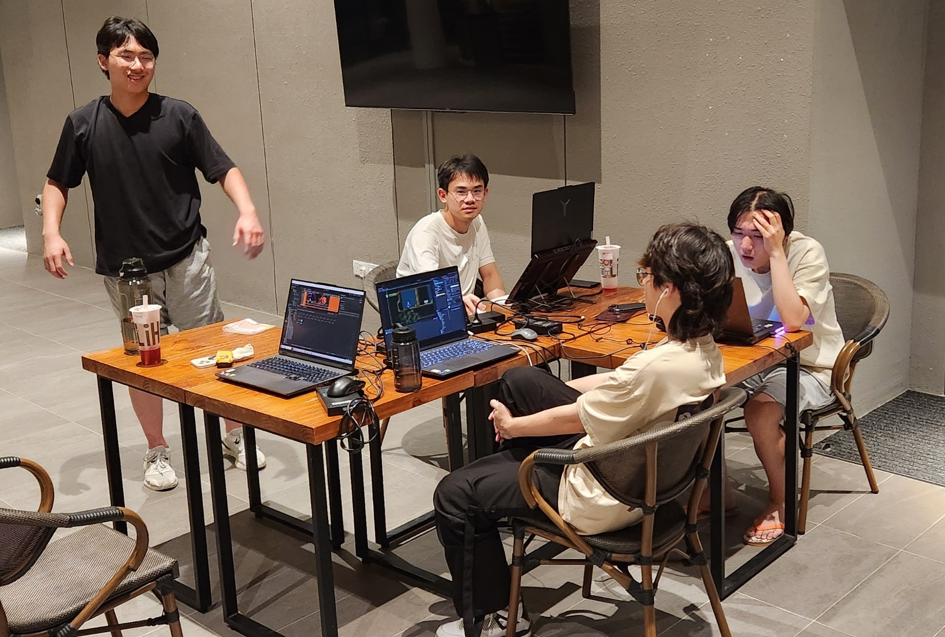
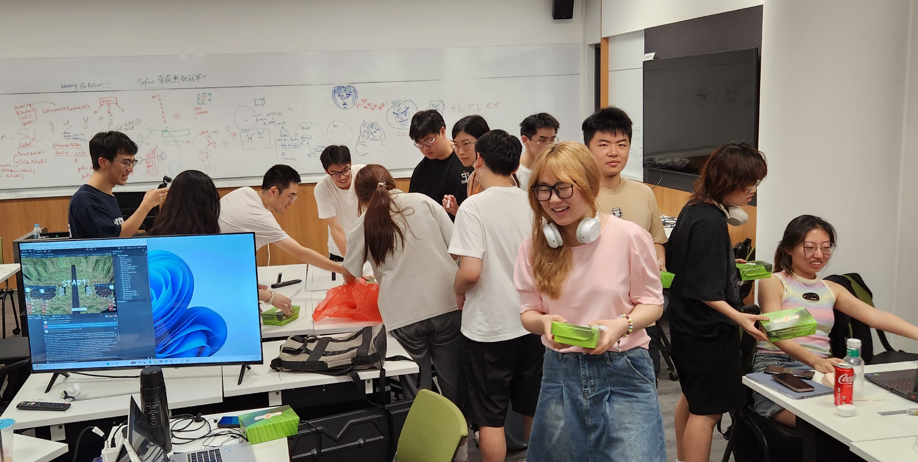
Quite a bit of work!

Slide 23
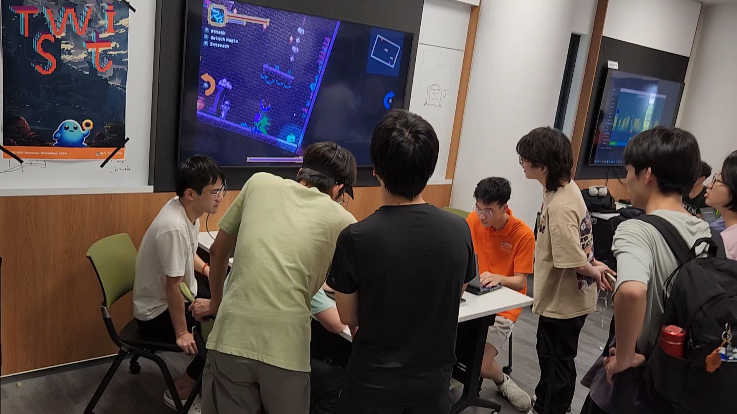
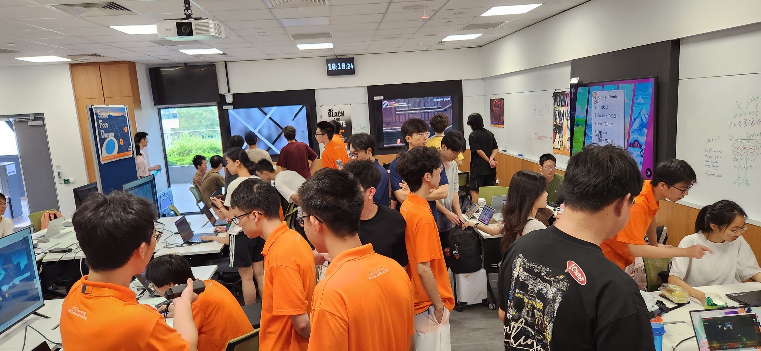
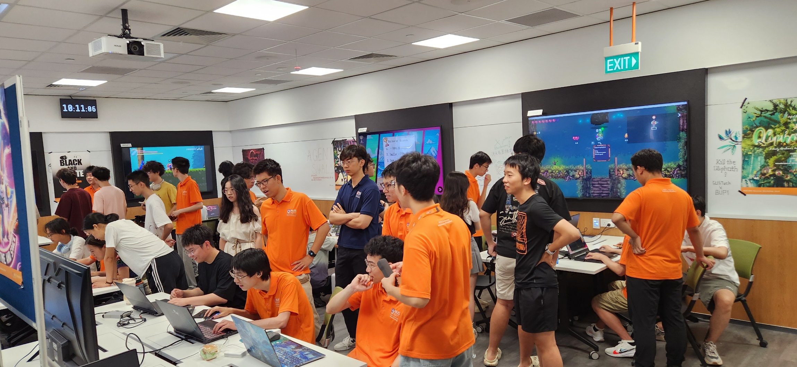
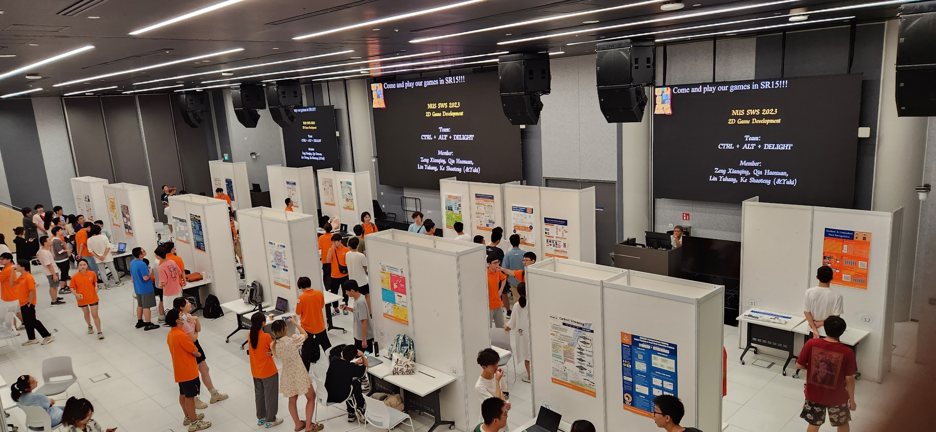
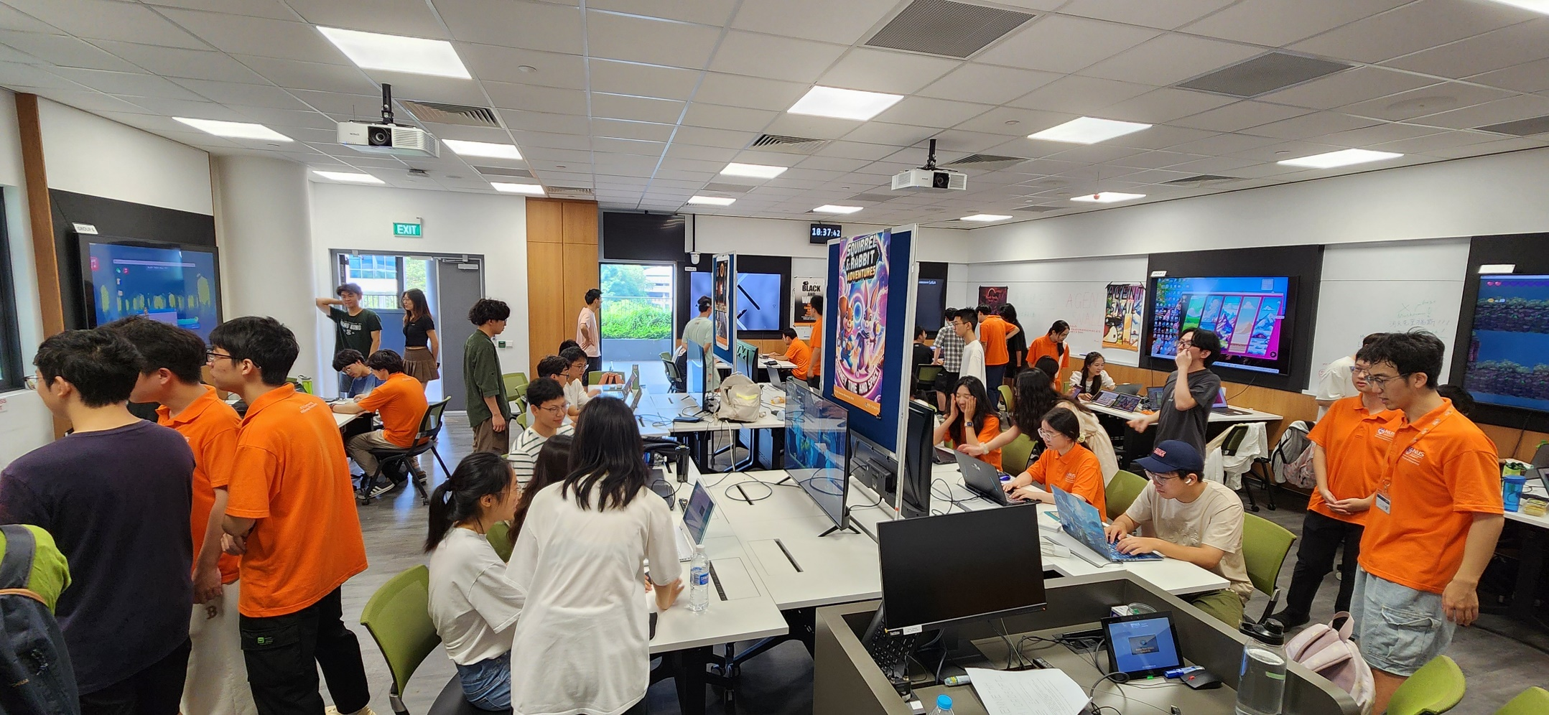
Work Hard … and …

Slide 24
Teaching and Learning
I teach based on:
Showing and demonstrating examples (ppts when appropriate)
Referring to lecture notes explaining the examples
Receiving questions/comments from you!!
You are responsible to learn by:
Following the examples in class [ASK questions]
Understanding the concepts behind the examples
Practicing and reviewing the concepts/skills by hands-on exercises
Remember to ask questions:
Unmute and speak!
Type in Chat and annotate “Q” (anywhere)

Slide 25
Questions?
My questions for you: … so far in our class …
What have you learned?
What is the single most important thing you have learned?

Slide 26
Today’s Agenda
WHO:
Who else are in the class, who am I
WHAT:
Topics coverage
WHEN:
Schedule of the class
HOW:
How to do well in class
Example
How I teach and what we will learn/do

Slide 27
… Let us begin …

Slide 28
https://myuwbclasses.github.io/IntroGameDev-NUS/

